Slide 1



Slide 2
Who is today’s instructor?
Santosh Kumar Kar
16+ years of experience
4 years as Java Instructor
12 years development, architecture & design
Hobbies: Playing videogames, reading story books, making new friends, sharing kowledge

Slide 3


Santosh Kumar Kar,
skkar.2k2@gmail.com

Slide 4
CHAPTER – 1
Spring Basics

Slide 5
Before Spring
Applets
EJBs
JDO (java data object)

Slide 6
Why Spring
Lightweight
Organized
Aspect-Oriented Programming (AOP)
Transaction Management
Container
Application testing
Dependency Injection
Easy Integration With Other Frameworks
Modularity
Convenient API

Slide 7
Spring Beans
Spring Beans are Java objects which are managed by the Spring container

Slide 8
Spring Container
The responsible for
instantiating,
configuring,
and assembling
the Spring Beans

Slide 9
Spring Modules
Spring Core
Spring Context
Spring ORM
Spring AOP
Spring DAO
Spring Web-MVC

Slide 10
Spring – Core: The IoC Container
IoC also known as DI (Dependency Injection)
Used Service Location Design pattern
2 main interfaces
BeanFactory (Basic)
ApplicationContext (Advanced)

Slide 11
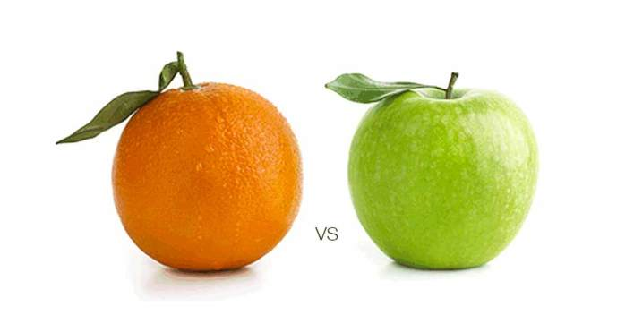
Bean Factory vs ApplicationContext
BeanFactory
lazy initialization approach
Supports scopes
Singleton
Prototype
ApplicationContext
Eager initialization approach
Supports I18N
Supports Annotation
Supports AOP Services
Supports
Singleton
Prototype
Request
Session
globalSession

Slide 12
The confused word: IOC
IOC is a design pattern that externalizes application logic so that it can be injected into client code rather than written into it. Use of IOC in Spring framework separates the implementation logic from the client
In very simple sentence we can say, the basic concept of IOC (Inversion of Control) pattern is that you don't create your objects but describes how they should be created.
Let us see one problem found while programming in Java. Then we will see how IOC provides the solution of this problem.

Slide 13
Spring Libraries
spring-aop
spring-asm
spring-beans
spring-context
spring-core
spring-expression
spring-jdbc
spring-test

Slide 14
Other Supported Libraries
aopalliance-1.0.jar
commons-logging-1.1.1.jar
junit-4.7.jar
log4j-1.2.14.jar
mysql-connector-java-8.0.16.jar

Slide 15


Slide 16

Problem: Need For Speed
There is a well known car racing computer game – NeedForSpeed. I have taken this example because most of us had played this game. You can Google if you want to know about this game ;)…
In this game, there are the participants use varieties of cars, such as
Ferrari
Jaguar
McLaren
Ford
Each type of car do have their own specifications say grip, accelerator, speed etc.
Now let’s write a program for this game.
There will be 1 generic class having common behavior. All the above different cars must inherit the common behavior of this generic class.
We will name the generic class as:- NeedForSpeedCar which should be an interface. Other car classes such as Ferrari, Jaguar, McLaren, Ford etc. must implement that interface.

Slide 17
The generic class which contains the declaration of the common behavior of all the cars. This is NeedForSpeedCar.java
//NeedForSpeedCar.java
package spring.test.santosh.game;
public interface NeedForSpeedCar{
String startEngine();
String accelerate();
}
Now we do have variety of cars. The specification of Ferrari is different from Jaguar and McLaren. Similarly McLaren specification is different from other cars. So each variety of car do have it's own implementaton. So let's see the implementation of those cars.

Slide 18
//Ferrari.java
package spring.test.santosh.game;
public class Ferrari implements NeedForSpeedCar{
public String startEngine(){
return ("Start engine of your Ferrari Car");
}
public String accelerate(){
return ("Accelerate and run fast your Ferrari Car");
}
}
//Jaguar.java
package spring.test.santosh.game;
public class Jaguar implements NeedForSpeedCar{
public String startEngine(){
return ("Start engine of your Jaguar Car");
}
public String accelerate(){
return ("Accelerate and run fast your Jaguar Car");
}
}

Slide 19
//McLaren.java
package spring.test.santosh.game;
public class McLaren implements NeedForSpeedCar{
public String startEngine(){
return ("Start engine of your McLaren Car");
}
public String accelerate(){
return ("Accelerate and run fast your McLaren Car");
}
}
//Ford.java
package spring.test.santosh.game;
public class Ford implements NeedForSpeedCar{
public String startEngine(){
return ("Start engine of your Ford Car");
}
public String accelerate(){
return ("Accelerate and run fast your Ford Car");
}
}

Slide 20
The Race is going to be started. So let’s write that class…
//Race.java
package spring.test.santosh.game;
public class Race{
public void startRace(){
//You choose your car-Ferrari
NeedForSpeedCar myracingcar = new Ferrari();
System.out.println(myracingcar.startEngine());
System.out.println(myracingcar.accelerate());
}
}
class Race has a dependency to class Ferrari
The class Race has a dependency to class Ferrari.
Now the car modules are ready.
The race is ready.
Let’s ask the Participant to start the race.
The participant is ready to use Ferrari.

Slide 21
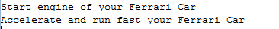
// Participant.java
package spring.test.santosh.game;
public class Participant{
public static void main(){
//You choose your car-Ferrari
Race race = new Race();
race.startRace();
}
}
Compile all the programs. And run Participant. The output would be:
Now it looks pretty good. The Participant run the car Ferrari.
See the next slide for what is the problem here…………………………………………

